Slide 1



Deep Learning-Based Plant Identification in Sri Lanka.
Group-10

Slide 2

Group Members
01
2018/ICTS/02- S.Rajagopal
02
2018/ICTS/64- P.R.D.N.Bandara
03
2018/ICTS/65- M.F.F.Farhana
04
2018/ICTS/67- T.N.Dharmasiri
05
2018/ICTS/68- U.M.J.M.Bandara
06
2018/ICTS/69- J.M.T.N.Jayasekara
07
07
2018/ICTS/71- C.Chayanthithan

Slide 3
Contents
01
Introduction
06
Results
02
Research Problem
07
Conclusion
03
Aim &Objectives
08
Challenges
04
Literature Review
09
Future Implementation
05
Materials &Methodology
10
References
07

Slide 4

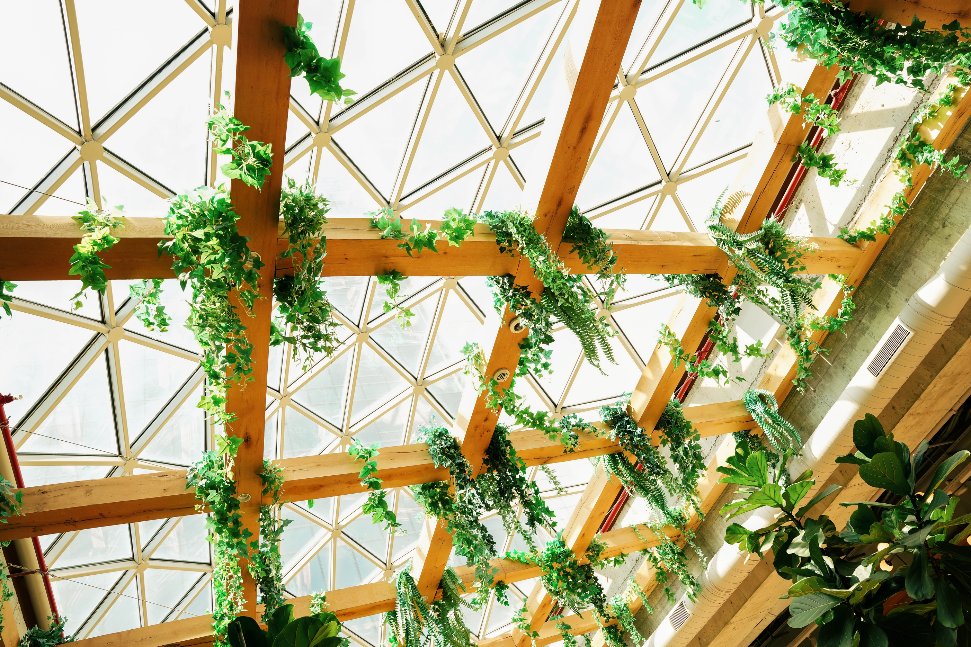


INTRODUCTION
Sri Lanka's diverse botanical landscape boasts a wide variety of plant species.
Traditional plant identification methods struggle with the diversity of leaf shapes, sizes, and textures.
Manual methods limit scalability for comprehensive botanical studies and conservation efforts
Technological Approach and Tools:
Approach:
Deep Learning techniques for leaf detection.
Tools:
Image Pre-processing: Resizing, normalization, augmentation.
Models:
MobileNetv2 for object detection .

Slide 5

RESEARCH PROBLEM
Motivation
Sri Lanka’s diverse plant species require scalable and accurate identification methods. Traditional approaches struggle with leaf variations and lack automation, motivating the use of deep learning for better efficiency and precision.
Research Questions
How can deep learning distinguish between visually similar leaf species for accurate identification?

Slide 6
AIM &OBJECTIVES
Aim
Accurately identify plant names using leaf images, automate the process for faster and more precise results, and enhance the understanding and management of Sri Lanka's plant diversity.
Objectives
•Detect plants by leaf characteristics.
•Create a database of Sri Lankan plant species.
•Support agricultural and ecological research.
•Promote awareness and education about plant diversity.
•Facilitate collaboration and knowledge sharing.

Slide 7
LITERATURE REVIEW
Topic | Methodology | Accuracy | Dataset Collection | Algorithms
Advancing Plant Identification Through Leaf Image Analysis (2022) | deep learning techniques. | Not specified | Various datasets (e.g., MalayaKew, Flavia) | CNN, Transfer Learning
Mobile-Based Assistive Tool to Identify Medicinal Herbs (2021) | deep learning and image processing | 83% | Custom dataset of Sri Lankan medicinal plants | Convolutional Neural Networks (CNN)
PSR-LeafNet: A Framework for Identifying Medicinal Plant Leaves (2024) | CNN-based feature extraction with Support Vector Machines (SVM) | 87.10% (Custom) | Publicly available datasets (MalayaKew, IMP) | PSR-LeafNet (P-Net, S-Net, R-Net) + SVM
Medicinal Plant Identification Using Deep Learning Techniques (2020) | Image preprocessing, CNN-based feature extraction | 75% | Custom medicinal leaf image dataset | Deep Convolutional Neural Networks (DCNN)
Hybrid Approach for Leaf Classification (2022) | Combines morphological features with texture analysis for improved classification. | 65% | Custom dataset and Flavia dataset | Hybrid of Morphological and Deep Learning

Slide 8
MATERIALS &METHODOLOGY
Materials
Software and Libraries
Google Colab: Cloud platform with GPU acceleration for efficient deep learning tasks.
Python: Programming language for model implementation.
Frameworks:
TensorFlow & Keras for model building and transfer learning with MobileNetV2.
ImageDataGenerator for image augmentation and preprocessing.
Matplotlib for visualizing accuracy and loss.
Hardware Resources
Google Colab GPU: Accelerates training for large datasets.
Storage: Google Drive for dataset storage and model checkpoints.

Slide 9
Materials &Methodology
Methodology
Data Collection
Data Augmentation
Model Architecture
Model Selection
Evaluation
Training Process
Visualization

Slide 10

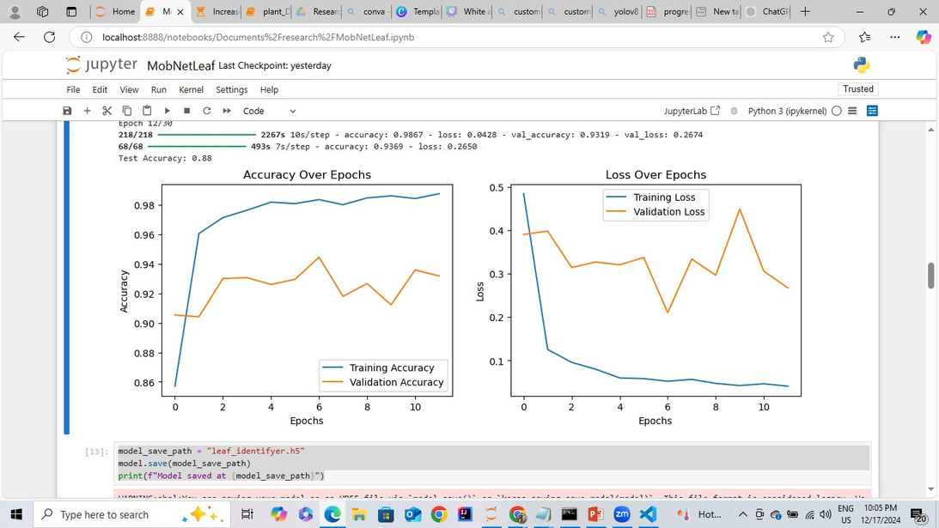
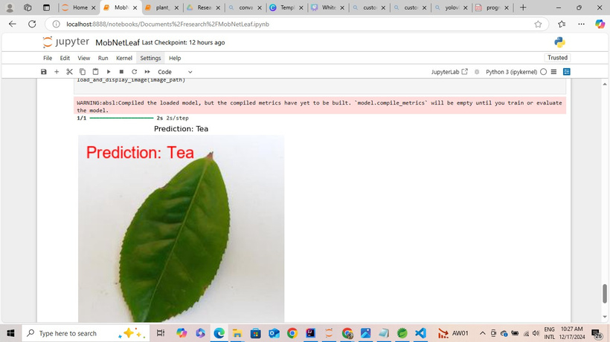
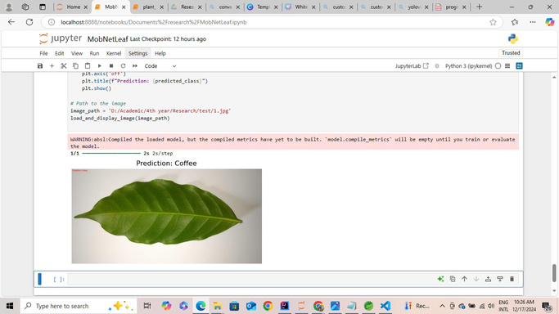
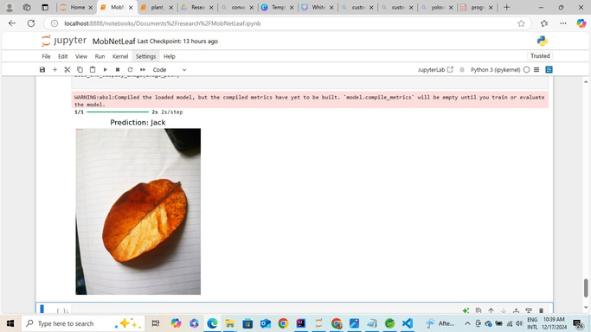
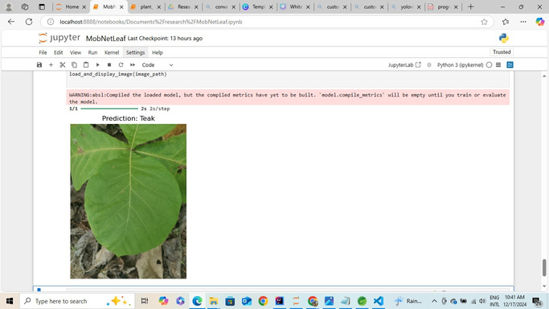
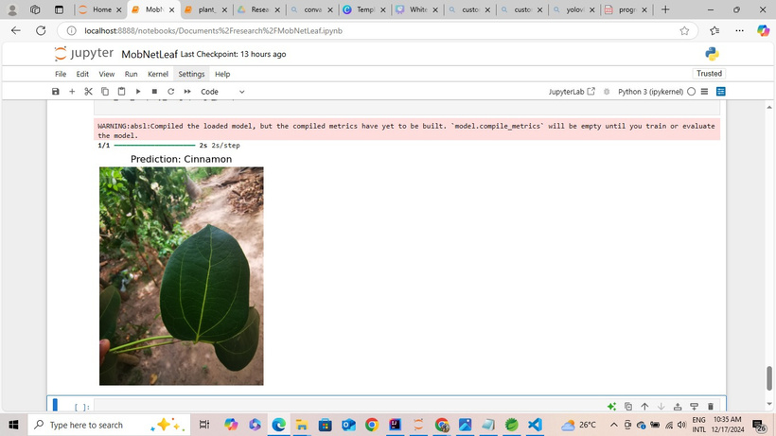
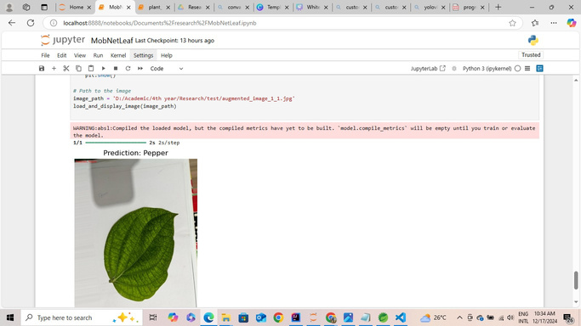
RESULTS
MobileNetV2 demonstrated strong performance with a training accuracy of 99% and testing accuracy of 93%
Tea
Coffee
Jack
Teak
Cinnamon
Pepper

Slide 11
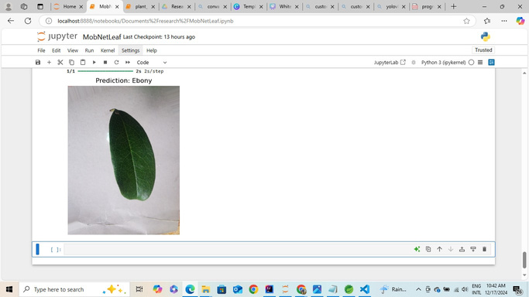
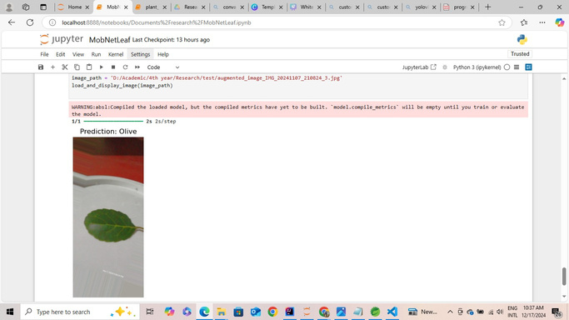
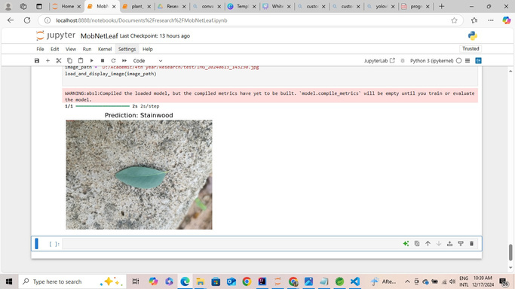
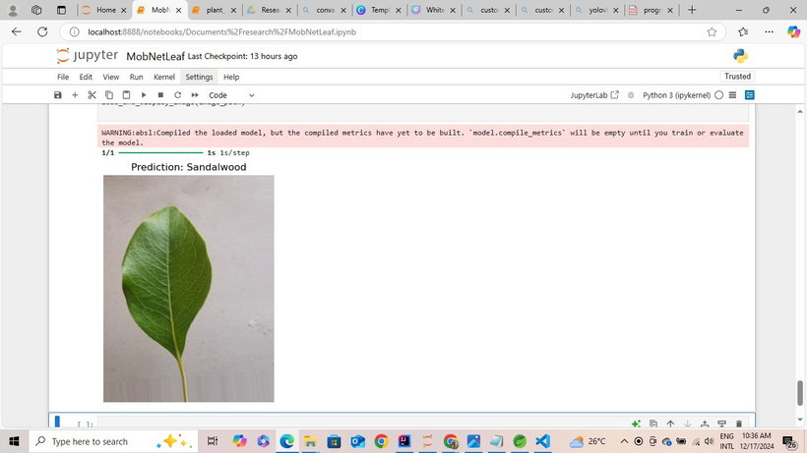
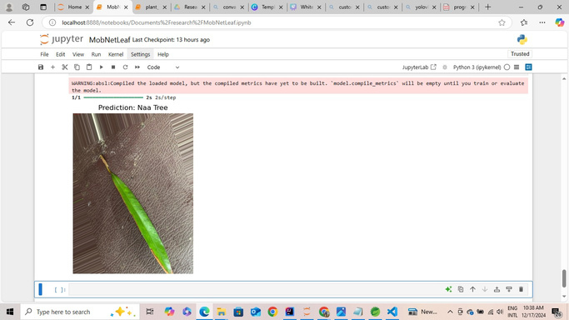
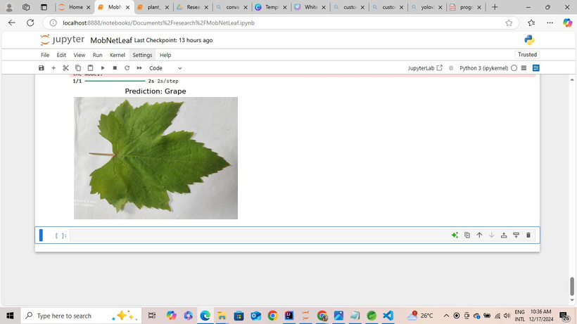
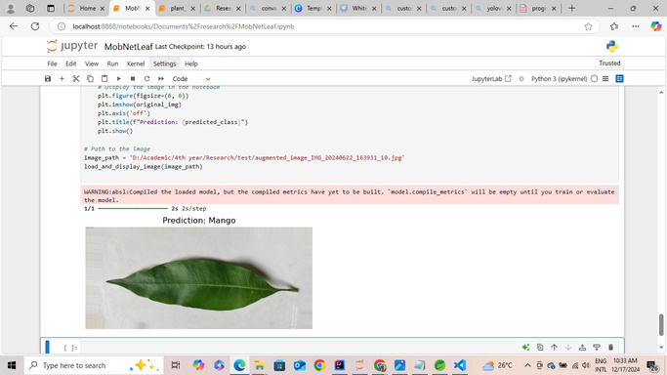
RESULTS
Ebony
Olive
Stainwood
Sandal wood
Naa Tree
Grape
Mango

Slide 12
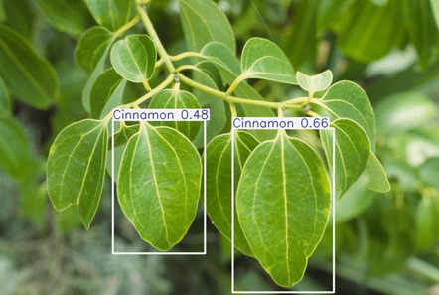
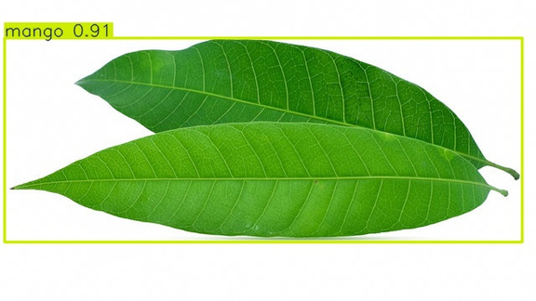
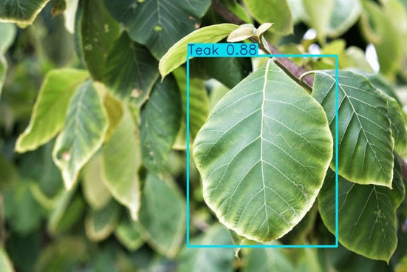
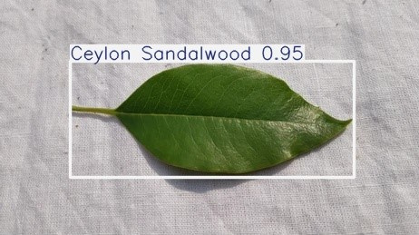
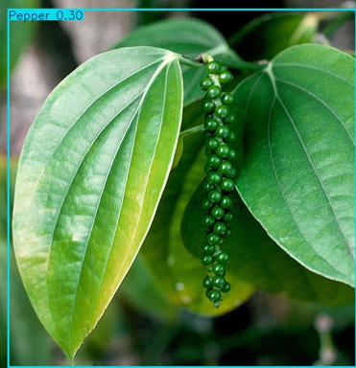
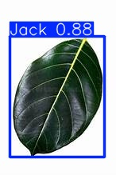
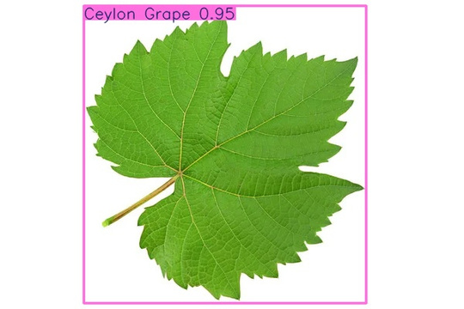
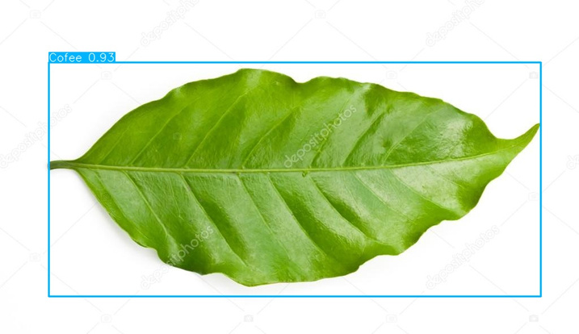
Discussion -(YOLOv8) Results
Cinamon
Mango
Teak
cylon sandalwood
Cofee
Pepper
Jack
Ceylon Grape

Slide 13
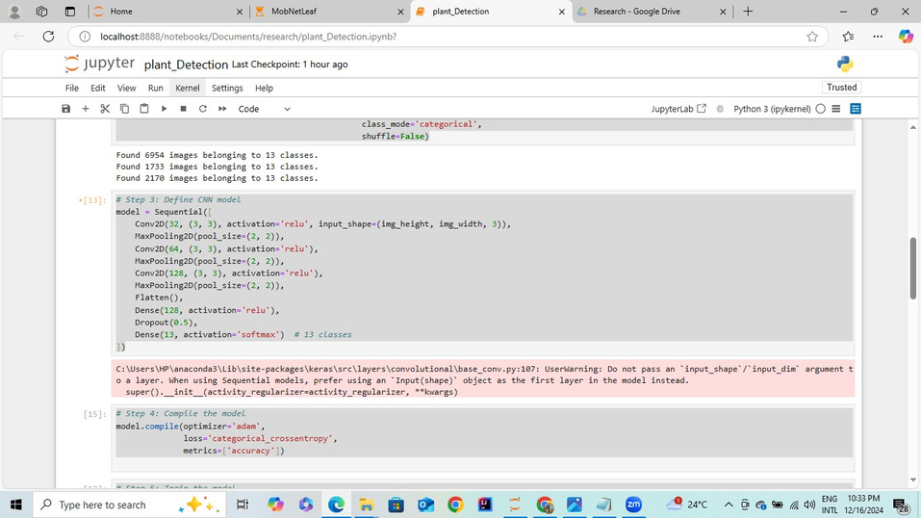
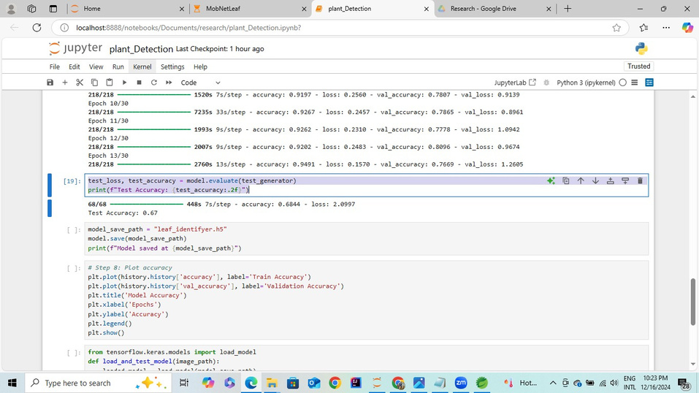
Discussion -(Custom CNN) Results
customCNN Accuracy is 67%

Slide 14
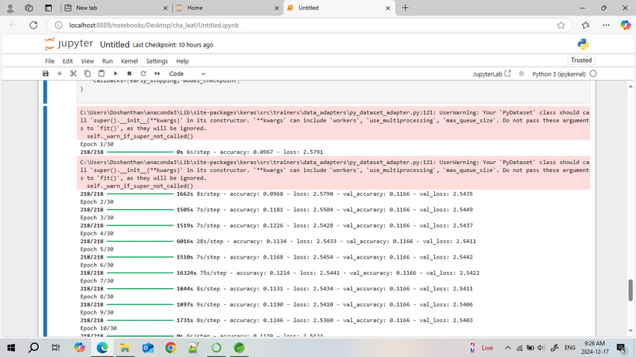
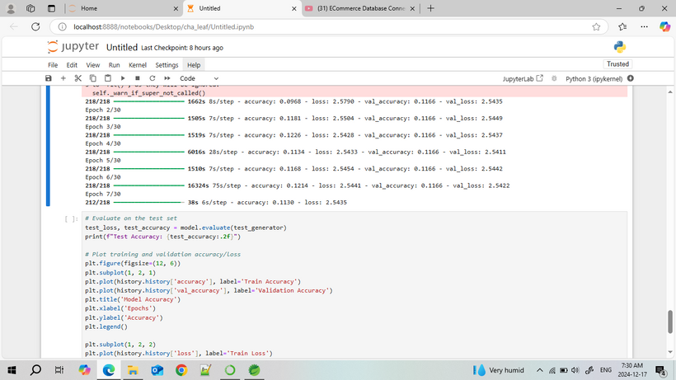
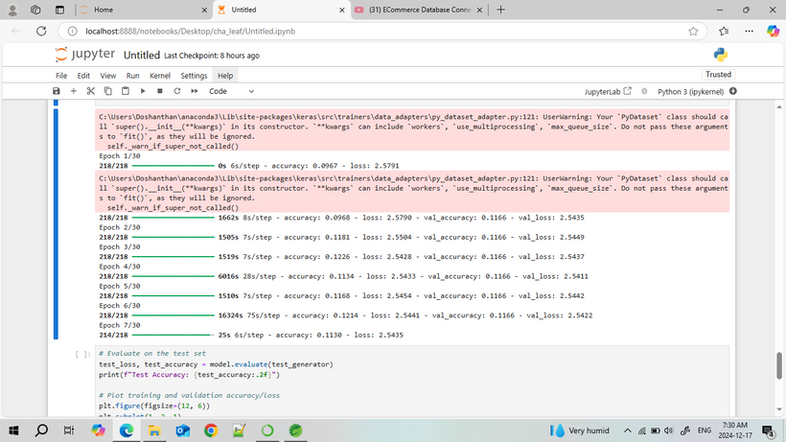
Discussion -(EfficientNetB0) Results
EfficientNetB0 Accuracy was very less.

Slide 15

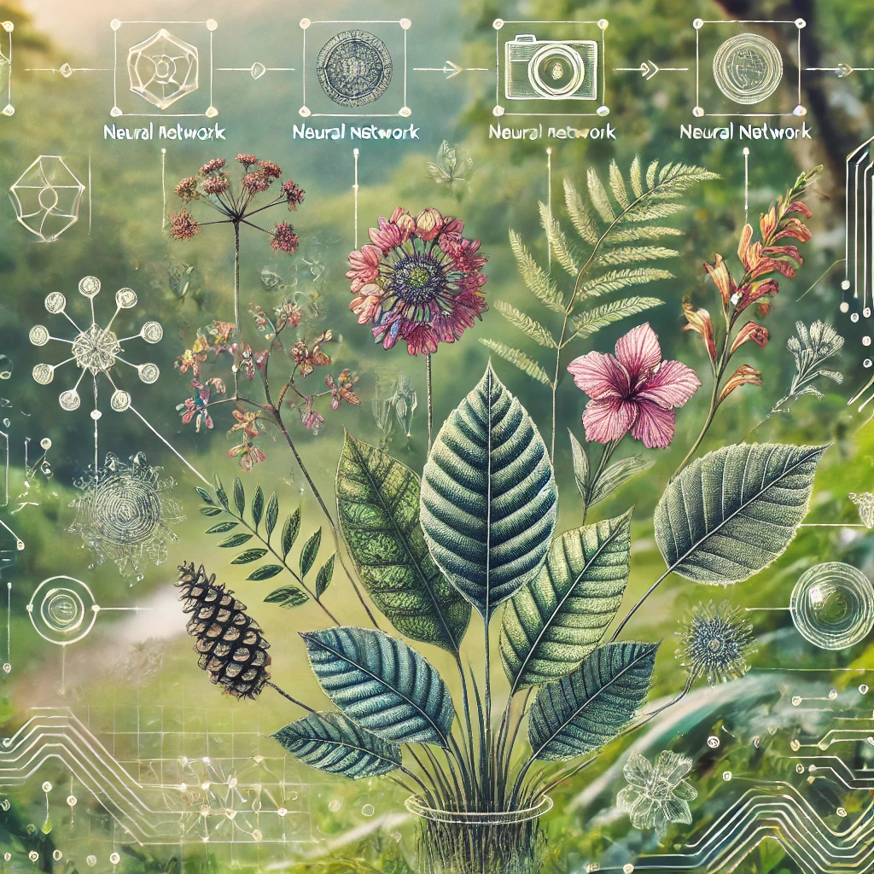





Conclusion
We have successfully completed key research tasks, including data collection, annotation, preprocessing, and model training.
Among the four models explored—YOLOv8, Custom CNN, MobileNetV2, and EfficientNet—MobileNetV2 achieved the best performance with a training accuracy of 99% and testing accuracy of 93%.
93%
Accuracy

Slide 16
Challenges
Storage/Computing: High resource needs for large datasets and model training.
Rare Leaves: Difficulty obtaining images of expensive or rare leaves.
Access Restrictions: Limited entry to certain gardens (e.g., sandalwood,Grape ).

Slide 17

Future works
Dataset Expansion: Add diverse leaf images, including rare and endangered species, and increase images of plants with similar leaf structures.
Automated Collection: Use drones or automated tools to capture leaf images from hard-to-access areas.
Mobile Application: Develop a real-time app for plant identification, enhancing accuracy for similar-looking leaves.
01
02
03

Slide 18
REFERENCES
1.S. Donesh et al., "Deep Learning for Plant Species Classification Using Leaf Vein Morphometric," in 2018 IEEE International Conference on Industrial Electronics for Sustainable Energy Systems (IESES), Hamilton, New Zealand, 2018, pp. 276–281. Available: https://ieeexplore.ieee.org/document/8388220.
2.D. P. Hughes and M. Salathé, "Using Deep Learning for Image-Based Plant Disease Detection," PLOS ONE, vol. 11, no. 6, pp. 1–15, Jun. 2016. Available: https://journals.plos.org/plosone/article?id=10.1371/journal.pone.0159347.
3."Advancing Plant Identification Through Leaf Image Analysis: A Comprehensive Review of Literature and Techniques," in 2022 IEEE International Conference on Emerging Trends in Engineering and Technology (ICETET), 2022, pp. 276–281. Available: https://ieeexplore.ieee.org/document/10303450.
4."Mobile-Based Assistive Tool to Identify & Learn Medicinal Herbs," in 2021 IEEE 10th International Conference on Awareness Science and Technology (iCAST), 2021, pp. 231–236. Available: https://ieeexplore.ieee.org/document/9394885.
5."PSR-LeafNet: A Deep Learning Framework for Identifying Medicinal Plant Leaves Using Support Vector Machines," Big Data and Cognitive Computing, vol. 8, no. 12, pp. 1–20, Dec. 2024. Available: https://doi.org/10.3390/bdcc8120176.

Slide 19
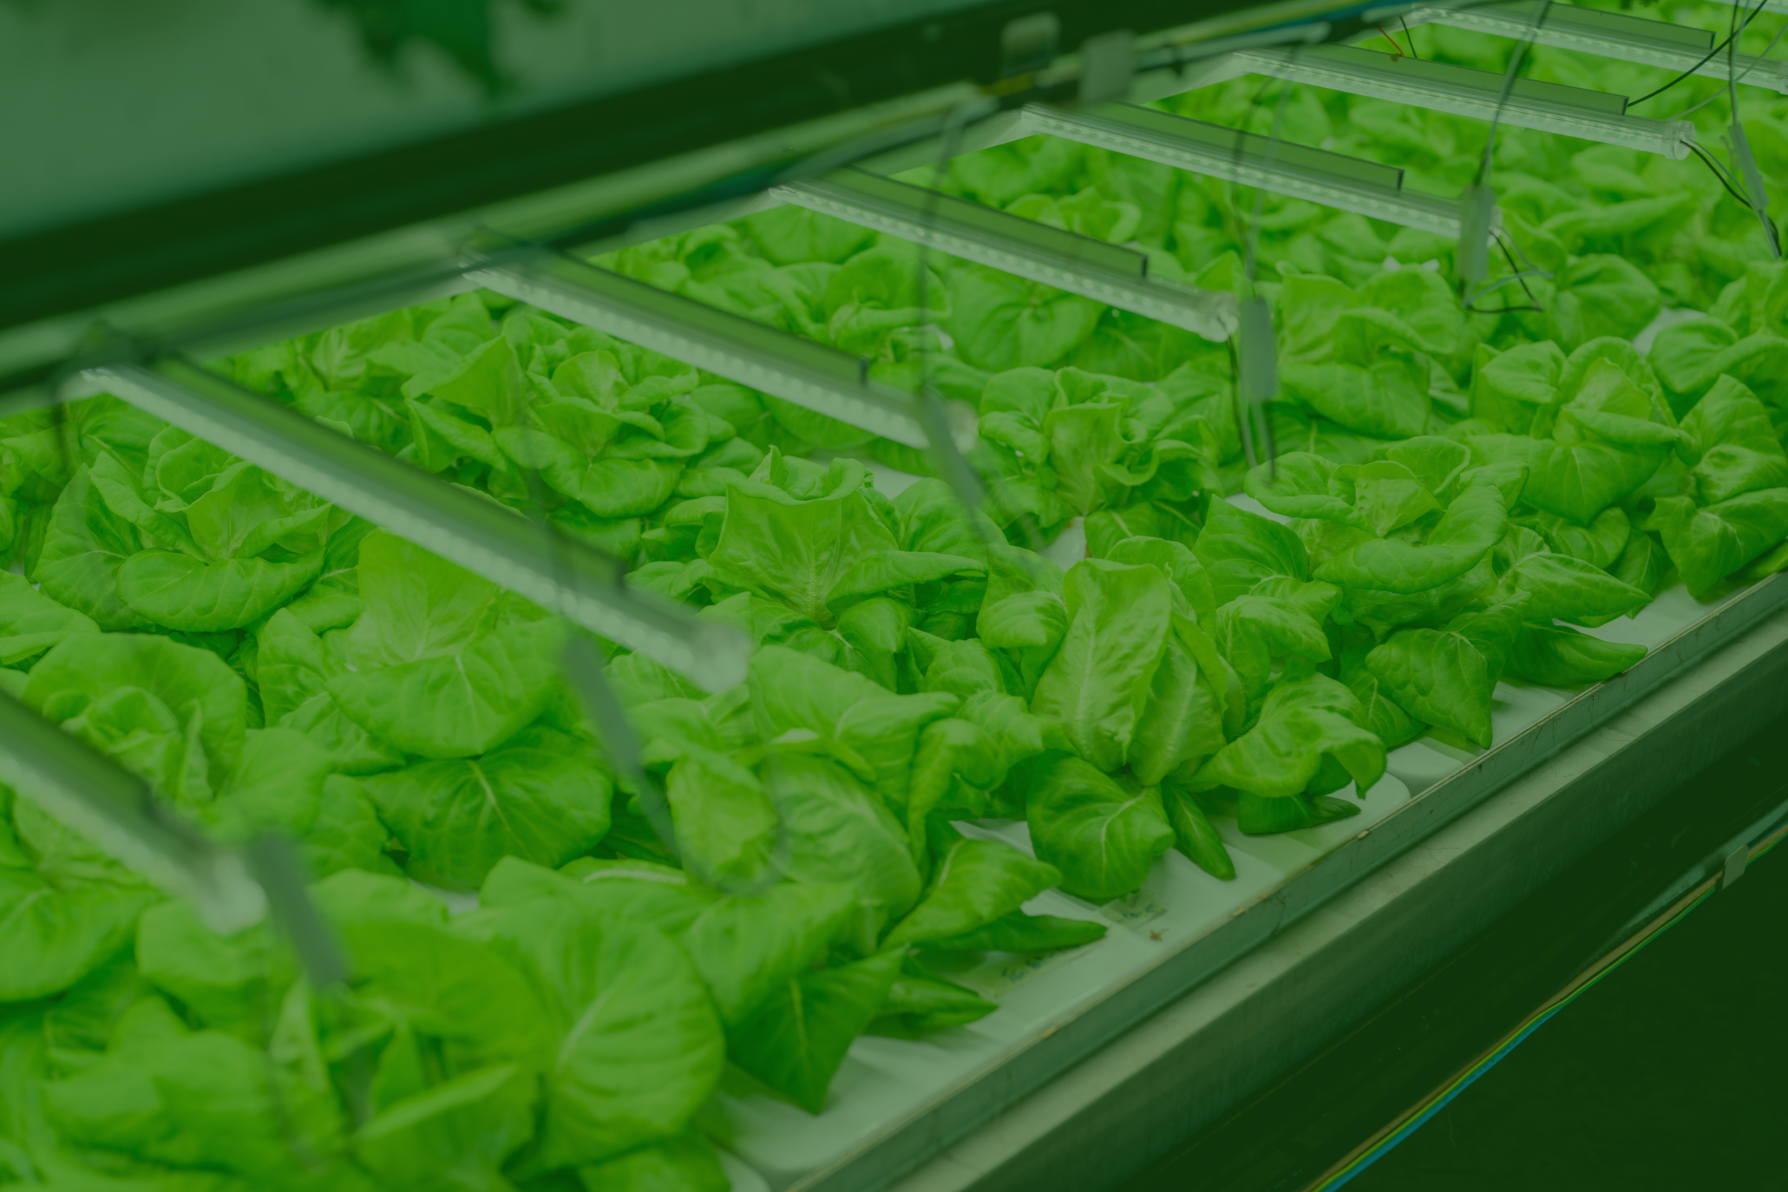
THANK YOU

